Slide 1
My Music Diary
Jenny Wei, Fangying Zhan
Cs 564, Summer 2020

Slide 2
Our presentation outline:
What is “My Music Diary”?
Why using database?
ER diagram and relational schema
Our datasets
DBMS and programming language choices
Architecture of our implementation
Demonstration
Evaluating our implementation

Slide 3
What is “My Music Diary”?
It is a stand-alone software that…
Provide detailed information of songs/albums/artists by a simple search
Display the song list of any album/artist by a single click
Recommend new songs that is close to your taste
Provide a safe and hearty space to record your feeling about a song at this moment

Slide 4
Why using database?
Need to deal with 55923 music records.
Too many data to manage! Use DBMS to reduce the cost.
DBMS is a great choice to collect, select and manipulate information from multiple datasets.

Slide 5
Our datasets
Amazon Music dataset from The 784 Data Sets for EM created by CS784 students at UW-Madison, Fall 2015 [1] .
Not very clean at first. Cleaning the dataset takes a while

Slide 6
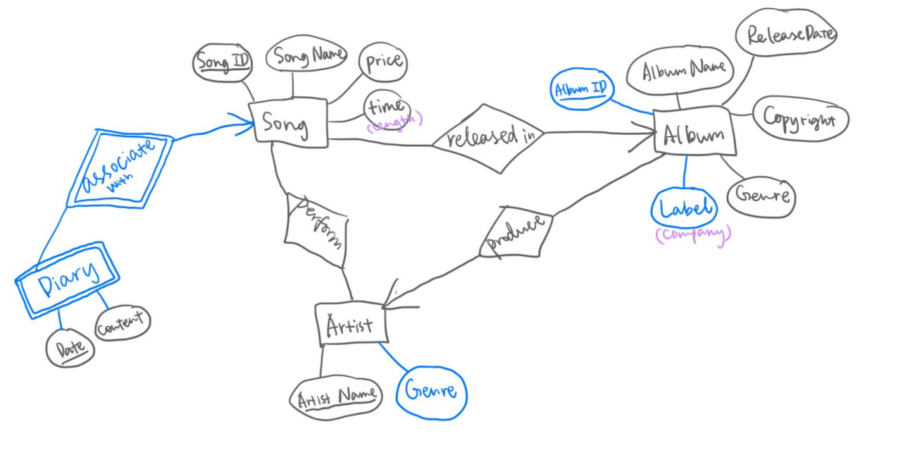
ER Diagram
4 entity sets; 4 relationships

Slide 7
Relational Schema
Including 5 tables:
Relational schema | Primary key | Additional key
Song(song_id: String, song_name: String, price: Real, time: String, album_id: String) | song_id | album_id + song_name
Album(album_ID: String, album_name: String, copyright: String, release_date: String, album_genre: String, label: String, producer_name: String) | album_id | album_name + release date
Artist:(artist_name: String, artist_genre: String) | artist_name | <None>
Diary(song_id: String, date: String, content: String) | song_id + date | <None>
Perform(song_id: String, artist_name: String) | song_id + artist_name | <None>

Slide 8
Normalization
All non-trivial functional dependencies has LHS as a superkey
All the relationships are originally in 3NF

Slide 9
DBMS and Programming Language Choices
DBMS: Mysql
Light weighted
Easy to learn and use
Easy to connect to Java
Interface: JavaFX
Powerful tool for GUI implementation
Flexible
All the team members are familiar with it

Slide 10
Architecture of Our Implementation
Output error information
AlertBox.java
Song.java
Define the song class
Pass parameters and create objective of certain class
Works as the main class and carry out all the panes.
MD_Login.java
Diary.java
Define the diary class
Deliver the query to MySQL and return the query result to MD_Login.java
SQL_Connect.java
MySQL
Perform the queries

Slide 11

Demonstration (video)

Slide 12
Evaluation
Whether queries are correct
By comparing MySQL query results and R language query results
whether query results are correctly shown in the interface
By comparing the MySQL query result and the interface output
Whether the interface performs smoothly
By checking the pane or error message after clicking each button

Slide 13
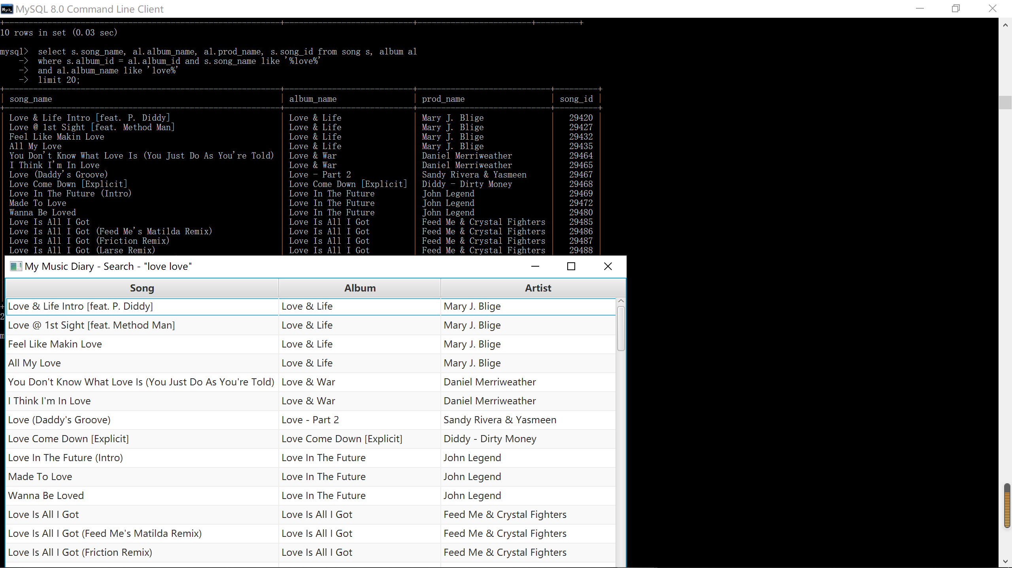
Evaluation example

Slide 14
Conclusion
What did we learn?
A lot.
Cleaning the data set to fit our ER diagram
Design SQL queries for real-life requirements
Design flexible interface that adapts to different query results
Most importantly, correctly cooperating with my partner

